Slide 1
Technical English for Computer Science
Week 5
Dr. Nur Banu OĞUR

Slide 2
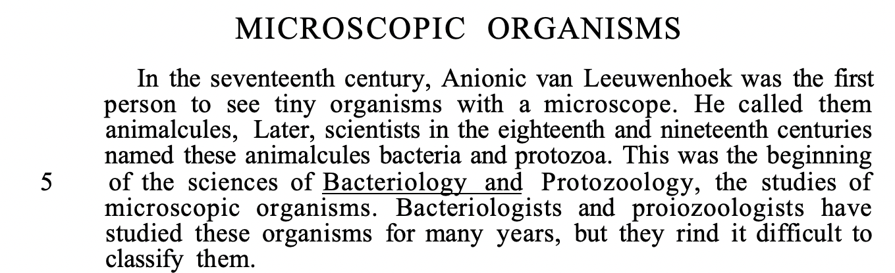

Slide 3
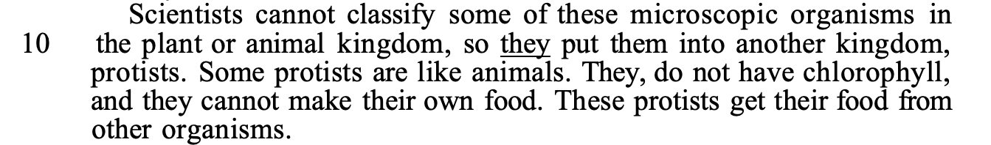

Slide 4
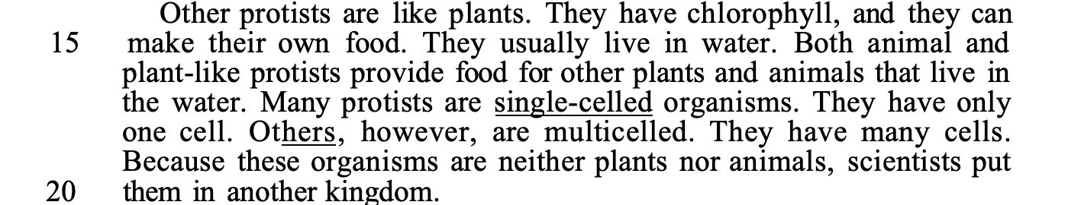

Slide 5
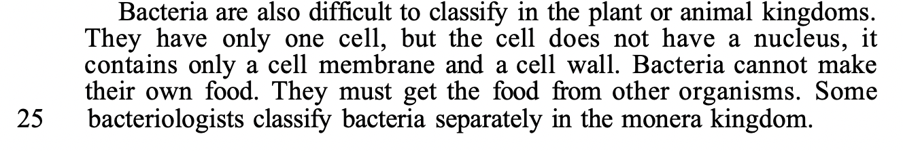

Slide 6
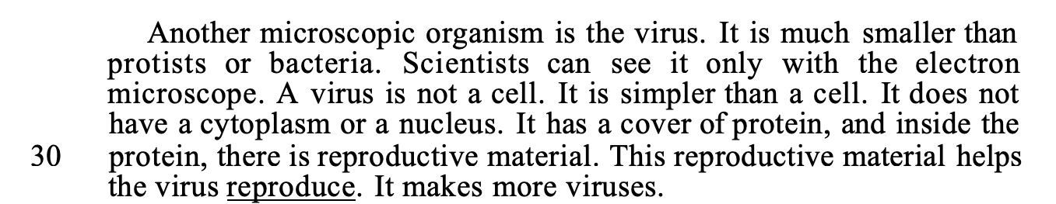

Slide 7
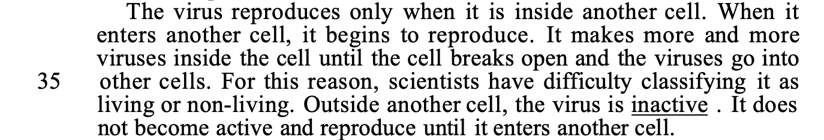

Slide 8
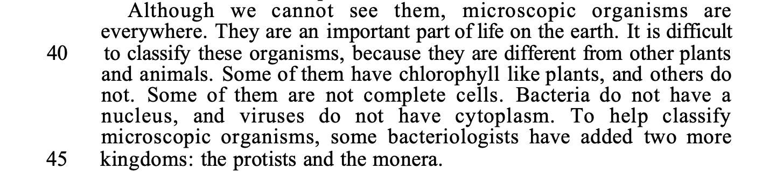

Slide 9
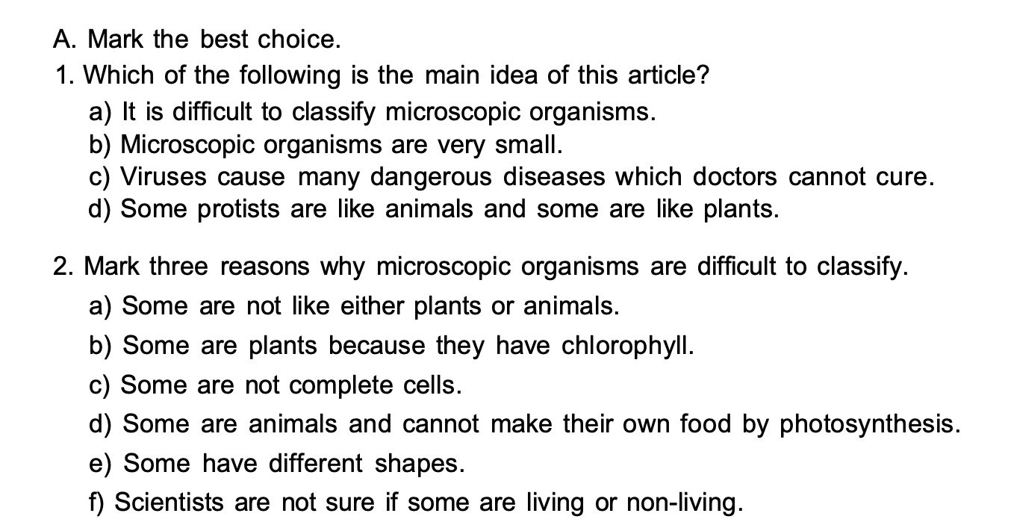

Slide 10
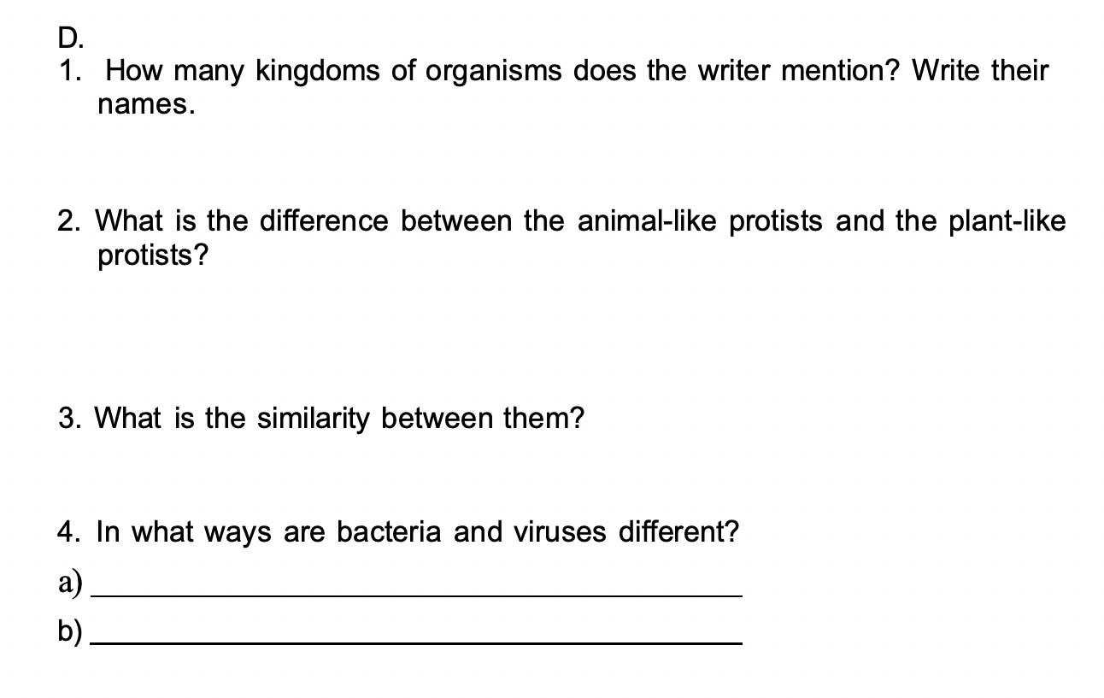

Slide 11
1.Animal kingdom, plant kingdom, protist kingdom, monera kingdom
2.Unlike animal-like protists, plant like protist have chlorophyll.
Unlike plant-like protist, animalike protist cannot make food/ get food from others.
3.Both provide food for other plant and animals that live in the water.
4-a)Bacteria have only one cell; o virüs is not a cell.
4-b)Viruses are much smaller than bacteria.

Slide 12
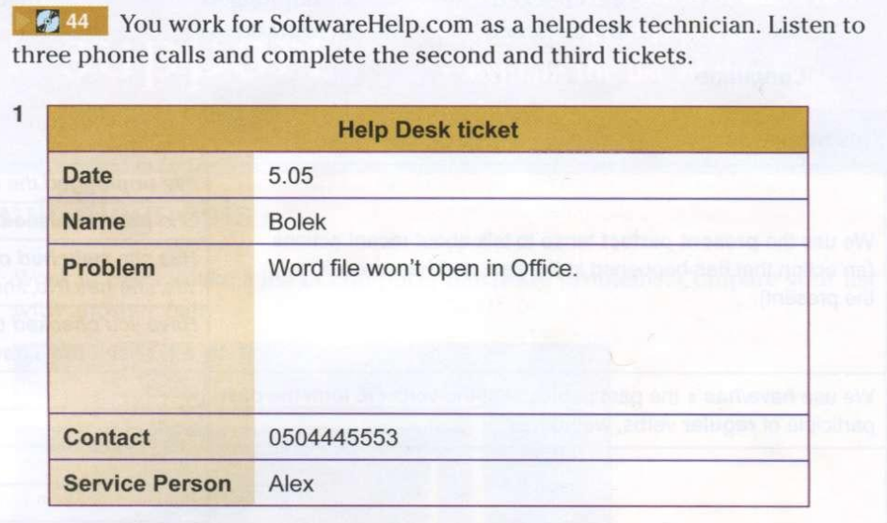

Slide 13
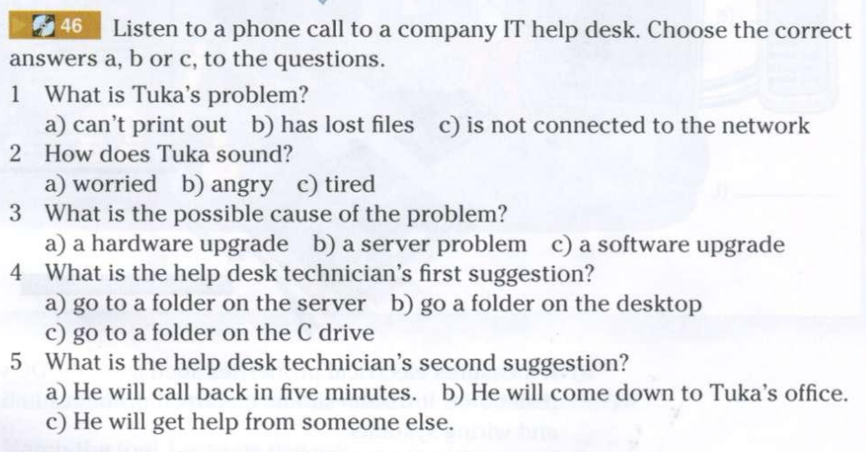

Slide 14
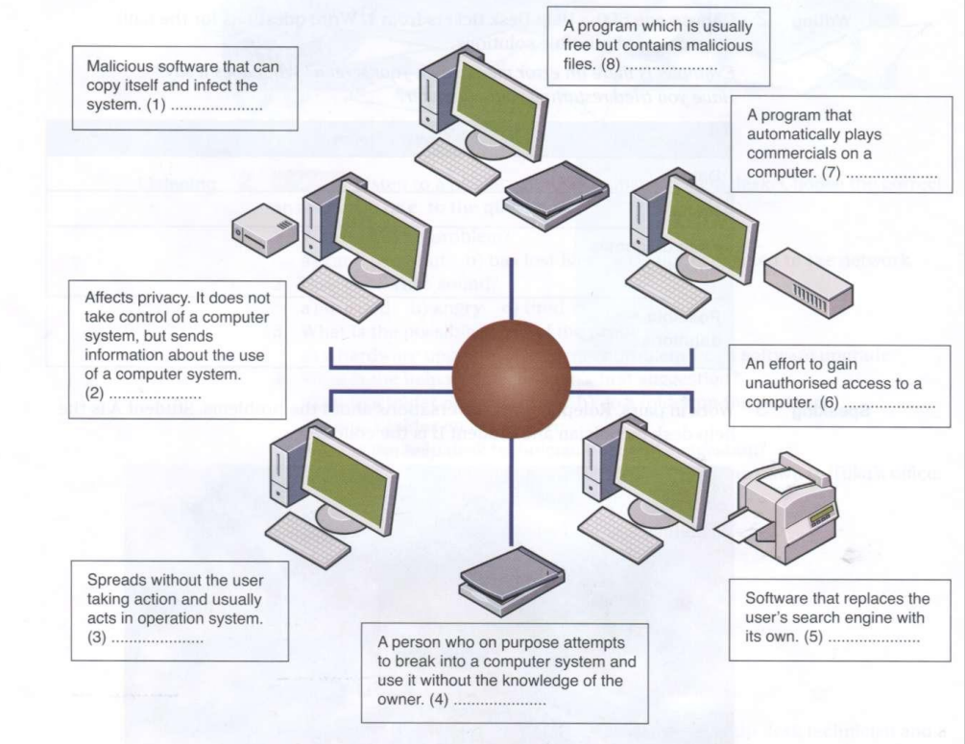
adware
hacker
browser
hijacker
malware attack
spyware
Trojan
virus
Worm

Slide 15
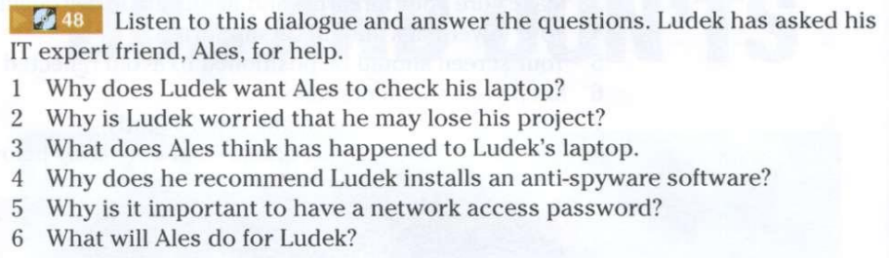

Slide 16
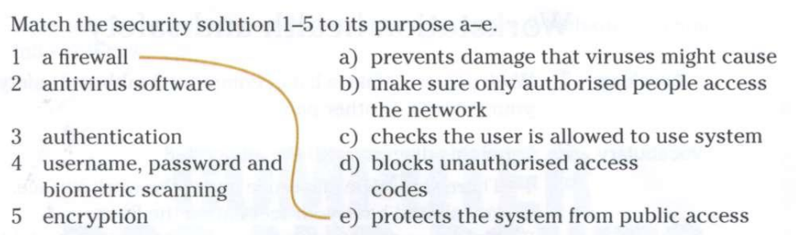

Slide 17
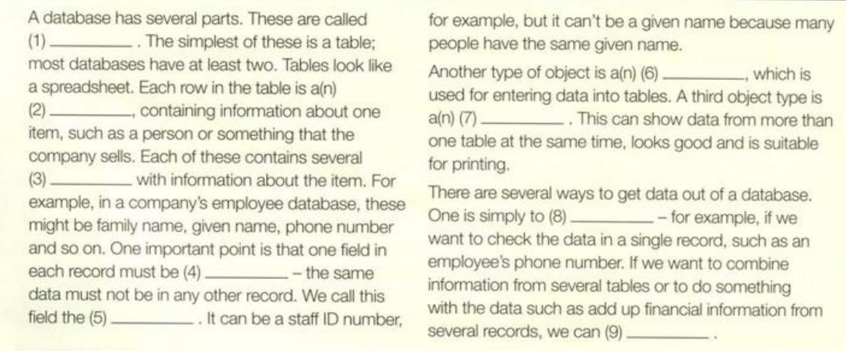
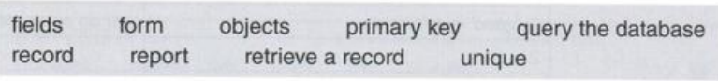
Complete this manual with the words

Slide 18
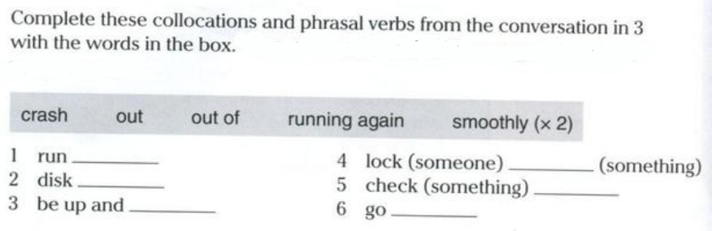

Slide 19
WRITING
What do you know about open source software?
How is it different from propreitary software?
Think about cost, who writes it and how much people use it.

